Slide 1



Binary Decision Diagrams
Giovanni De Micheli
Integrated Systems Laboratory
This presentation can be used for non-commercial purposes as long as this note and the copyright footers are not removed
© Giovanni De Micheli – All rights reserved

Slide 2
Module 1
Objectives:
  Definitions of BDDs, OBDDs and ROBDDs
  Logic operations on BDDs
  The ITE operator

Slide 3
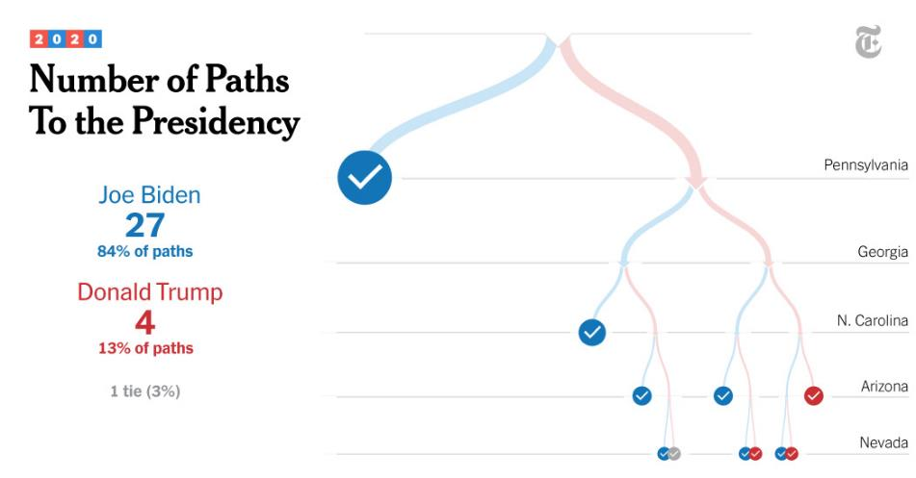
2020 US election – while counting one day after

Slide 4
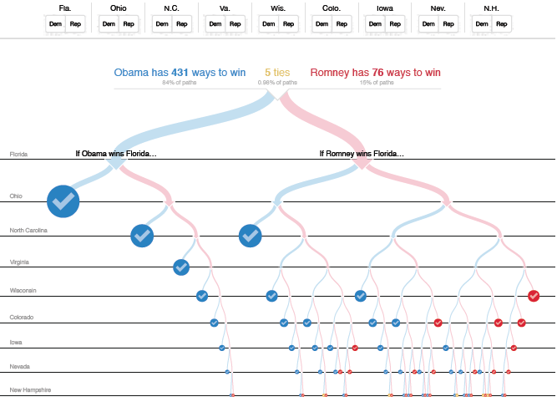

Slide 5
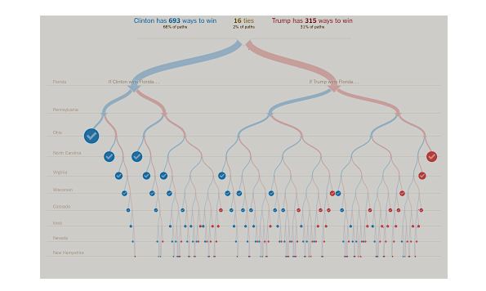
US 2016 elections

Slide 6
Motivation
Efficient way to represent logic functions
History
  Original idea for BDD due to Lee (1959) and Akers (1978)
  Refined, formalized and popularized by Bryant (1986)
    Smaller memory footprint
    Canonical form – each distinct function correspond to a unique distinct diagram
Notes:
Binary decision diagrams (or BDDs) were proposed by Lee and later by Akers to represent scalar Boolean functions.
Many variations on this theme have been proposed.
In Aker's model, the decisions are the evaluation of a variable.
Bryant showed that efficient algorithms can manipulate decision diagrams under a mild assumption on the ordering of the decision variables.
For this reason, Bryant's diagrams are called ordered binary decision diagrams or OBDDs.
Moreover, these diagrams are canonical when reduced, i,e., for reduced ordered binary decision diagrams or ROBDDs

Slide 7
Canonical forms - review
Each logic function has a unique representation
Truth table
Sum of minterms
a | b | c | F
0 | 0 | 0 | 0
0 | 0 | 1 | 0
0 | 1 | 0 | 0
0 | 1 | 1 | 1
1 | 0 | 0 | 0
1 | 0 | 1 | 1
1 | 1 | 0 | 0
1 | 1 | 1 | 1
a’bc+ab’c+abc
Notes:
There are a few canonical representations of logic functions, such as
Truth tables (exponential size)
Sum of product of minterms
Note that sum of product representations are NOT canonical.

Slide 8
Non canonical forms - review
Each function has also multiple representations
Factored form
Logic network representation
(a+b)c
ac+bc
a
c
a
b
c
b
Notes:
Examples of non canonical representation include factored forms and logic networks.

Slide 9
Terminology
A Binary Decision Diagram (BDD) is a directed acyclic graph
  Graph: set of vertices connected by edges
  Directed: edges have direction
  Acyclic: no path in the graph can lead to a cycle
Often abbreviated as DAG
  Simplest model:
    Two leaves (Boolean constants 0 and 1)
    One root
    Can degenerate to a tree
Notes:
A binary decision diagram represents a set of binary-valued decisions, culminating in an overall decision that can be either true or false.
Decision diagrams can be represented by trees or rooted dags, where decisions are associated with vertices.

Slide 10
BDD - Example
F = (a + b) c
a | b | c | F
0 | 0 | 0 | 0
0 | 0 | 1 | 0
0 | 1 | 0 | 0
0 | 1 | 1 | 1
1 | 0 | 0 | 0
1 | 0 | 1 | 1
1 | 1 | 0 | 0
1 | 1 | 1 | 1
a
0
1
b
c
0
1
0
1
c
c
b
b
0
1
0
1
0
1
0
1
0
0
0
1
0
0
1
1
Each vertex represents a decision on a variable
The value of the function is found at the leaves
Each path from root to leaf corresponds to a
row in the truth table
Notes:
This examples puts a truth table in correspondence with a BDD.
Each line of the table corresponds to a leaf.
The path from root to leaf determines the function.

Slide 11
BDD - observations
The size of a BDD is as big as a truth table:
  1 leaf per row
  Exponential size
Each path from root to leaf evaluates variables in some order
  But the order is not fixed:
  (a,b,c) and (a,c,b)
  Free BDD
a
0
1
b
c
0
1
0
1
c
c
b
b
0
1
0
1
0
1
0
1
0
0
0
1
0
0
1
1
Notes:
For general BDDs (also called free BDDs) there is no advantage over other forms.
The size is still exponential in the input variable count.

Slide 12
1st idea: Ordered BDD (OBDD)
Choose arbitrary total ordering on the variables
  Variables must appear in the same order along each path from root to leaves
  Each variable can appear at most once on a path
example:
a < b < c
a
0
1
b
b
0
1
0
1
c
c
c
c
0
1
0
1
0
1
0
1
0
0
0
1
0
1
0
1
Notes:
Bryant showed that efficient algorithms can manipulate decision diagrams under a mild assumption on the ordering of the decision variables.
For this reason, Bryant's diagrams are called ordered binary decision diagrams or OBDDs.

Slide 13
2nd idea: Reduced OBDD (ROBDD)
Two reduction rules:
  Merge equivalent sub-trees
  Remove nodes with identical children
a
0
1
b
b
0
1
0
1
c
c
c
c
0
1
0
1
0
1
0
1
0
0
0
1
0
1
0
1
Notes:
OBDDs have more practical applications than other types of decision diagrams.
OBDDs can be transformed into canonical forms that uniquely characterize the function.
This can be done by removing redundancy in the diagrams by two steps:
Merging isomorphic subtrees
Removing nodes with identical children

Slide 14
1. Merge equivalent sub-trees
a
a
0
1
0
1
b
b
b
b
0
1
0
1
0
1
0
1
c
c
c
c
c
c
0
1
0
1
0
1
0
1
0
1
0
1
0
0
0
1
0
1
0
1
0
1
before
after
Notes:
This example shows the first steps in reduction.

Slide 15
2. Remove node with identical children
a
a
0
1
0
1
b
b
b
0
1
0
1
0
1
c
c
c
0
1
0
1
0
1
0
1
0
1
before
after
Notes:
This example shows the next steps to make a ROBDD.

Slide 16
ROBDDs
ROBDDs are canonical
  For a given variable order
ROBDD are more compact than other canonical forms
  Efficient representation
ROBDD size depends on the variable order
  Many useful functions have linear-space
  (or slightly above) representation
x₁
x₂
x₂
x₃
x₃
x₄
x₄
0
1
Notes:
ROBDD are canonical form: this can be formally proved.
They are usually very compact, and provide us with a very efficient representation of functions.
Their size depends on the variable order: thus there are “good” and “bad” orders.

Slide 17
BDD semantics
Constant nodes
ITE(x,F1,F0)
0
1
else edge
x
then edge
0
1
0-cofactor
1-cofactor
F₀
F₁
Cofactor(F,x): the function you obtain when you substitute 1 for x in F
Notes:
In a ROBDD, the root corresponds to the function itself and the leafs to the Boolean constants 0 and 1.
Each other node has two children, with edges to the two cofactors with respect to the variable associate with the node (and its complement).
Note that sometimes ROBDDs are just called BDDs for simplicity.

Slide 18
A few simple functions
F = (a+b)c
0
1
a
0
1
F = bc
F = 0
F = 1
b
0
1
F = c
c
x
0
1
F = 1
0
1
0
1
0
1
F = x
Notes:
This example shows a ROBDD for a simple function and its construction.

Slide 19
A network example
a
a
0
1
0
1
0
1
c
c
0
1
a
0
1
0
1
0
1
0
1
b
0
1
c
0
1
0
1
b
b
0
1
0
1
c
0
1
0
1
0
1
Notes:
This example shows the construction of a ROBDD for the function representing the output of a loc network.
Such ROBDD can be constructed by traversing the network from input to output.

Slide 20
ROBDD- sharing
We already share subtrees within a ROBDD
…but we can share also among multiple ROBDDS
G = dbc
d
0
1
F = (a+b)c
Order:
d < a < b < c
a
0
1
b
shared
0
1
c
0
1
0
1
Notes:
Multiple-output functions can be represented by multi-rooted ROBBDs.
Sharing of subtrees is key to keeping the representation compact.

Slide 21
ROBDDs- why do we care ?
Easy to solve some important problems:
  Tautology checking
    Just check if BDD is identical to function
  Identity checking: F = G
  Satisfiability
    Look for a path from root to leaf 1
All while having a compact representation
  Use small memory footprint
1
Notes:
With BDDs many important problems can be solved efficiently.
Indeed, tautology checking is just verifying that the ROBDD is the leaf 1.
Identity checking is verifying that two ROBDDs are the same.
Satisfiability corresponds to looking for a path from root to leaf.

Slide 22
Logic operations with ROBDDs
Cofactor
  Given: ROBDD for $G$
  Positive co-factor $G_{x}$ wrt. $x$: restrict $G$ to $x = 1$
  Remove every node with label $x$, redirect incoming edges to node with then edge
  Negative co-factor $G_{x′}$wrt. $x$: restrict $G$ to $x = 0$
  Remove every node with label $x$, redirect incoming edges to node with else edge
else edge
x
then edge
0
1
0-cofactor
1-cofactor
F₀
F₁

Slide 23
Logic operations with ROBDDs
Boolean operators $⋆$ ($⋅$, $+$, $⊕$, …)
  Given: two ROBDD for $G$, $H$
  Find: the ROBDD of $G⋆H$
  ite operator:
    ite(f,g,h) = fg + f’h
    If (f) then (g) else (h)
  Recursive paradigm
    Exploit the generalized expansion of G and H
    ite (f,g,h) = ite(x,ite(f_{x},g_{x},h_{x}),ite(f_{x’}, g_{x’},h_{x’}))
Notes:
The ROBDD construction and manipulation can be done with the ite operator, which
takes its name from its operative definition. Given three scalar Boolean functions :f,g and h, ite(f,g,h) = f g + f' h which is equivalent to: if f then g else h.
In particular, functions f,g and h can be Boolean variables or constants.
We assume that all variables are ordered and we call top variable of a function (or set of functions) the first variable in the support set (or in the union of the support sets.)
The manipulation of the ROBDDs is done using the recursive paradigm.
Indeed the ite of three arguments can be computed by the ite of their cofactors.

Slide 24
Example
Apply AND to two ROBDDs: f,g
  fg = ite (f,g,0)
Apply OR to two ROBDDs: f,g
  f+g = ite (f,1,g)
Similar for other Boolean operators
Notes:
Logic operations on functions can be reconduced to applying the ite operator to their BDDs.
As an example, the AND of two functions is like an ite with an empty (0) else branch body.
The OR of two functions f+g is ite(f,1,g)= f.1 +f’g = f+f’g = f+g.

Slide 25
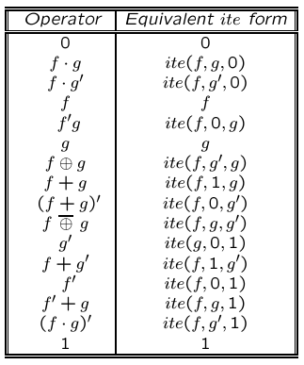
Boolean operators
Notes:
There are 16 Boolean connectors, or ways to combine logic functions.
This table shows how to compute each connector using the ite operator.

Slide 26
ROBDD construction – terminal cases (AND)
Consider a simple example: compute AND of two ROBDDs
Terminal cases:
  AND (0,H) = 0
  AND (1,H) = H
  AND (G,0) = 0
  AND (G,1) = G
Notes:
This slide is the beginning of an example showing how to operate on BDDs.
In particular it shows ANDing two BDDs.
The terminal cases, once a BDD is a constant leaf, are tabulated above.

Slide 27
ROBDD construction – recursive step (AND)
G(x,…) =x’ G_{x=0}+ x G_{x=1}
H(x,…) =x’ H_{x=0}+ x H_{x=1}
F = GH = x’ G_{x=0} H_{x=0} + x G_{x=1}H_{x=1}
F
x
0
1
    Now we have reduced the problem to computing 2 ANDs of smaller functions
G_{x=0}H_{x=0}
G_{x=1}H_{x=1}
Notes:
This slide continues the example.
The AND of two BDDs can be done recursively by ANDing the cofactors.
The AND of the cofactors gives two terms, as two other vanish.
Thus, the AND of two BDDs can be trivially deduced by knowing the AND of the cofactors.
In the end, you get to the terminal case when one (or both BDDs) are constant.

Slide 28
One last problem
Suppose we have computed
G_{x=0} H_{x=0} and G_{x=1}H_{x=1}
We need to construct a new node,
  label: x
  0-cofactor(F_{x=0}): ROBDD of G_{x=0} H_{x=0}
  1-cofactor(F_{x=1}): ROBDD of G_{x=1} H_{x=1}
BUT, we need first to make sure that we don’t violate the reduction rules!
Notes:
Finally, once we have the AND of two cofactors, we should introduce a new node, representing the AND.
But we need to make sure that this node does not already exist: in this case we just need to add edges.

Slide 29
The unique table
To obey reduction rule #1:
  If F_{x=0} == F_{x=1}, the result is just F_{x=0}
To obey reduction rule #2:
  We keep a unique table of all the BDD nodes and check first if there is already a node
  (x, F_{x=0}, F_{x=1})
Otherwise, we build the new node
  And add it to the unique table
Notes:
Thus, if the two cofactors of the AND of a function are the same functions, we keep only one.
Next, if they are different, we introduce a new node only if such node does not exist.
To check this, we keep a table, called unique table, that stores the triples (x, F_{x=0}, F_{x=1}).
We keep the unique table updated at all times.
By doing so, operating on two ROBDDs always yields a reduced OBDD by construction.

Slide 30
Putting all together
AND(G,H) {
if (G==0) || (H==0) return 0;
if (G==1) return H;
if (H==1) return G;
cmp = computed_table_lookup(G,H);
if (cmp != NULL) return cmp;
x = top_variable(G,H);
G1 = G.then; H1 = H.then;
G0 = G.else; H0 = H.else;
F0 = AND(G0,H0);
F1 = AND(G1,H1);
if (F0 == F1) return F0;
F = find_or_add_unique_table(x,F0,F1);
computed_table_insert(G,H,F);
return F;
}
Notes:
This algorithm describes the ANDing of two functions G and H.
At first, the trivial cases are considered, when a BDD is a leaf.
Next, we do a lookup in a cache, called computed table, to see if the current computation was previously done and the result reused.
This step is key to speeding up the algorithm by removing redundant computation.
Then, the cofactors are computed with respect to the top variable.
The AND of the cofactors is computed. If they match, one is discarded.
Last, a lookup in the unique table is done to see if the new node is needed or not.

Slide 31
Generalizing to Boolean operators
ITE(F,G,H) {
if (terminal case) return (r = trivial result);
cmp = computed_table_lookup(G,H);
if (cmp != NULL) return (r = cmp);
x = top_variable(F,G,H);
t = ITE (F_{x} , G_{x} , H_{x} )
e = ITE (F_{x’} , G_{x’} , H_{x’})
if (t == e) return (r = t);
r = find_or_add_unique_table(x,t,e);
computed_table_insert{(F,G,H),r};
return ( r );
}
Notes:
This algorithm describes the ITE of three functions, F, G and H. The ITE can be used to compute any function of these functions.
The previous algorithm is just a special case.
At first, the trivial cases are considered, when a BDD is a leaf.
Next, we do a lookup in a cache, called computed table, to see if the current computation was previously done and the result reused.
This step is key to speeding up the algorithm by removing redundant computation.
Then, the cofactors are computed with respect to the top variable.
The ITE of the cofactors is computed. If they match, one is discarded.
Last, a lookup in the unique table is done to see if the new node is needed or not.

Slide 32
Logic operations - summary
Recursive routines – traverse the DAGs depth first
Two tables:
  Unique table – hash table with an entry for each BDD node
  Computed table – store previously-computed partial results
Time complexity is quadratic in the BDD sizes
Notes:
In summary, operating on ROBDDs is efficient. It can be done in quadratic time.
Two tables help speeding the computation:
The unique table that stores the triples
The computed table that acts as a cache.

Slide 33
Some algorithmic complexities
  Checking tautology K time
  Checking identity K time
  Satisfiability linear (#vars)
  Binary operators: AND, OR quadratic
  Smoothing, Consensus quadratic
Notes:
This slide shows the complexity of various operations in the size of the BDD.

Slide 34
Motivation - again
Why are ROBDD popular?
  Several intractable problems can be solved in polynomial time
    Of the BDD size
  In several cases, the BDD sizes grow mildly with the problem size
    Variables
This does not mean that BDD solve intractable problems in polynomial time
  Few counterexamples exists
Notes:
ROBDDs are popular because they enable fast computation of many problems.
Note that the key is that in most instances, the ROBDD size grows mildly with the problem size.
There are counterexample showing that in some cases the ROBDDs grow over-polynomially with the problem size.
Thus, it is false that BDD solve in general intractable problems in polynomial time.

Slide 35
Module 2
Objectives:
  Variable ordering (static and dynamic)
  Other diagrams and applications

Slide 36
The importance of variable order
a
a
b
b
d
d
c
c
c
c
b
d
d
c
c
0
1
0
1
Notes:
The same function may have ROBDDs with different size according to the order of the variables.

Slide 37
Ordering results
  In practice:
    Many common functions have reasonable size
    Can build ROBDDs with millions of nodes
    Algorithms to find good variables ordering
Function type | Best order | Worst order
addition | linear | exponential
symmetric | linear | quadratic
multiplication | exponential | exponential
Notes:
For some arithmetic functions, there are bounds on the size of the BDD representation.
The multiplication operation gives always exponential-size ROBDDs.

Slide 38
Variable ordering algorithms
Problem: given a function F, find the variable order that minimizes the size of its ROBBDs
Answer: problem is intractable
Two heuristics
  Static variable ordering (1988)
  Dynamic variable ordering (1993)
Notes:
The variable ordering problems means finding n order of the variables that minimizes the ROBDD size.
This problem is intractable. Exact and heuristic algorithms exist.

Slide 39
Static variable ordering
Variables are ordered based on the network topology
  How: put at the bottom the variables that are closer to circuit’s outputs
  Why: because those variables only affect a small part of the circuit
  Disclaimer: it is a heuristic, results are not guaranteed
a
b
good order: a < b < c
c
Notes:
In static ordering, the variables are ordered according to the network topology.
The strategy is to put at the bottom the variables that are closer to circuit’s outputs.
This method works well in most cases, but not always.
It is a simple idea, with little overhead.

Slide 40
Dynamic variable ordering
Changes the variable order on the fly whenever ROBDDs become too big
How: trial and error – sifting algorithm
    Choose a variable
    Move it in all possible positions of the variable order
    Pick the position that leaves you with the smallest ROBDDs
    Choose another variable …
Notes:
In dynamic ordering, the order of the variables is changed when the BDD sizes passes over a threshold.
The sifting algorithm is often used.
It is a simple heuristic again.
It takes a variables, and it move it in the order one position at a time.
Eventually, it is placed in the position that minimizes the size.
Then, another variable is considered, and so on…

Slide 41
Dynamic variable ordering
Tiny example: F=(a+b)c
  We want to find the optimal position for variable c
a
a
c
0
1
0
1
1
0
Final order:
c<a<b
b
c
c
a
1
1
0
1
0
1
0
0
c
b
b
0
1
0
1
0
1
0
1
0
1
0
1
initial order:
a < b < c
Swap (b, c):
a < c < b
Swap (a, c):
c < a < b
Notes:
This example shows the effect of moving variable c through the order, and the corresponding ROBDDs.

Slide 42
Variable swapping
F
F₀
F
F₁
F₀
x_{i}
F₁
x_{i+1}
x_{i+1}
x_{i+1}
x_{i+1}
x_{i+1}
x_{i}
x_{i}
F₀₀
F₀₁
F₁₀
F₁₁
F₀₀
F₀₁
F₁₀
F₁₁
Notes:
The key idea in the sifting algorithm is to exchange position of variables that are adjacent in the order.
This is because such a swap can create at worse an increase of 2 nodes in the ROBDD, and such ROBDD can be easily computed.
The example shows how to construct the new ROBDD after the swap.
Note that only a layer that is “two variable thick” is affected.

Slide 43
Dynamic variable ordering
Key idea: swapping two variables can be done locally
  Efficient:
    It can be done just by sweeping the unique table
  Robust:
    It works well on many more circuits
  Warning:
    It is still non optimal
    At convergence, you most probably have found only a local minimum
Notes:
In summary, the sifting algorithm is simple but efficient in many cases.

Slide 44
Improvements on BDDs
Complement edges (1990)
  Creates more opportunities for sharing
    Fewer nodes
  For every pair (F,F’), we
    Only construct the ROBDD for F
    F’ is given by using a complement edge to F
  Which do you pick ?
    THEN edge can never be complemented
    Only constant value
F
F’
1
Notes:
There have been extension to the ROBDDs. The most important one is the use of complemented edges.
A bubble on an edge denotes a local negation.
Note that this gives more opportunities for subgraph sharing, and thus the ROBDD gets more compact.
In particular, only one leaf is enough.
It is important to note that there is a restriction: the ‘then” edge cannot be complemented.
This restriction is to preserve canonicity.

Slide 45
Complement edges
F = x
Still canonical
x₁
x
x
0
1
0
1
0
1
x₂
1
1
0
1
x₃
0
1
x₄
0
1
1
Notes:
These are examples of ROBDDS with complemented edges.

Slide 46
Other types of Decision Diagram
Based on different expansion
  OFDD
  Ordered functional decision diagrams
For discrete functions:
  ADD
  Algebraic decision diagrams
x₀
x₁
x₁
0
1
2
3
Notes:
There are some variations of BDDS.
For example, ordered functional decision diagrams (OFDDs) are based on another decomposition.
Algebraic decision diagrams (ADDs) are good to represent discrete functions.

Slide 47
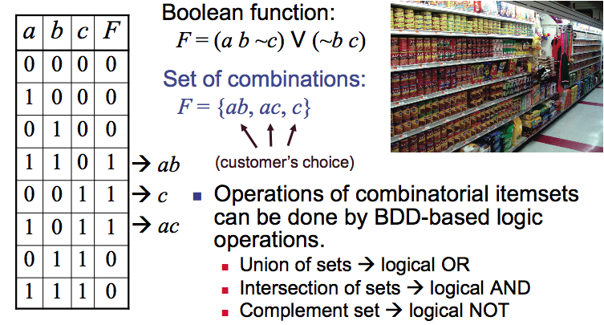
Boolean functions and sets of combinations
Observing customers:
Pasta & tomantoes & (not pesto)
Pesto & (not tomatoes)
We care about what they take
Notes:
Zero-suppressed decision diagrams (ZDDS) are BDDs with other reduction rules.
In particular, all nodes whose 1-edge points to the 0-leaf are eliminated and the incoming edges are redirected to the 0-subgraph.
ZDDs are good to represent ensembles of subsets, which are typically very sparse.

Slide 48
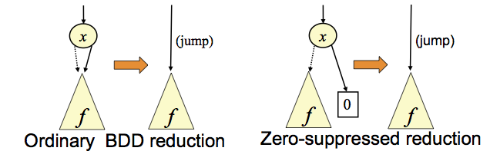
ZDDs -- Zero-suppressed BDDs
BDDs with different reduction rules
  Eliminate all nodes whose 1-edge points to the 0-leaf and redirect incoming edges to the 0-subgraph
  Share all equivalent subgraphs
If item x does not appear in any itemset, the ZDD node is eliminated
  When average occurrence ratio of each item is 1%, than ZDD are more efficient than BDDs (up to 100 times)
Notes:
Zero-suppressed decision diagrams (ZDDS) are BDDs with other reduction rules.
In particular, all nodes whose 1-edge points to the 0-leaf are eliminated and the incoming edges are redirected to the 0-subgraph.
ZDDs are good to represent ensembles of subsets, which are typically very sparse.

Slide 49
ZDD - example
Itemset {a,b}; characteristic function F = ab’c’ + a’bc’
a
a
1
a
1
0
0
0
b
b
b
1
b
b
1
1
1
1
1
0
0
c
0
0
1
0
0
0
1
0
1
0
1
  Eliminate all nodes whose 1-edge points to the 0-leaf and redirect incoming edges to the 0-subgraph
Notes:
Classical BDDs represent completely specified Boolean functions.
To represent sets, a set is put in one-to-one correspondence with its char. function.
For each item, a minterm is added to the on-set of the char. function.

Slide 50
ZDD - UNION
UNION(G,H) {
if (G=={}) return H;
if (H=={}) return G;
if (G==H) return G;
cmp = computed_table_lookup(G,H);
if (cmp != NULL) return cmp;
x = top_variable(G,H);
G1 = G.subset1; H1 = H.subset1;
G0 = G.subset0; H0 = H.subset0;
F0 = UNION(G0,H0);
F1 = UNION(G1,H1);
if (F0 == F1) return F0;
F = find_or_add_unique_table(x,F0,F1);
computed_table_insert(G,H,F);
return F;
}

Slide 51
Summary
BDDs
  Very efficient data structure
  Efficient manipulation routines
  A few important functions don’t come out well
  Variable order can have a high impact on size
Application in many areas of CAD
  Hardware verification
  Logic synthesis
Notes:
Overall BDDs have been applied to many problems in CAD, such as synthesis and verification.
They are very efficient for manipulating Boolean functions. They work well in most cases: notable exceptions are multipliers.

